Slide 1
Programming Fundamentals in C++
(Practical#6)

Slide 2
Objective: To become familiar with Structures in C++
A structure is a collection of simple variables.
The variables in a structure can be of different types, some can be int, some can be float , char and so on.
The data items (variables) in a structure are called member of the structure.
Structure is a collection of variables of different data types under a single name.
OR collection of data of different data types.
OR Collection of Heterogeneous data types

Slide 3
A structure is a user defined data type in C++.
A structure creates a data type that can be used to group items of possibly different types into a single type.
Structure is defined by the (programmer):
The structures are called user defined or programmer defined data types:

Slide 4
Student
Name Rollno Dept. ….
Employee
empno ename jobtitle hiredate salary ….

Slide 5
Structures
Declaring the structure
Defining a structure variable
Accessing the members of the structure

Slide 6
Declaring the structure
The structure declaration tells how the structure is organized:
It specifies what variables the structure will have.
The structure declaration does not set aside any space in memory or even define any variables.

Slide 7
Declaring the structure
Example Keyword
Structure name or “tag”
struct students
{
int rollno;
int obtMarks; Structure Members
float per;
};
Semicolon terminate Specifier

Slide 8
Declaring the structure
The structure declaration tells how the structure is organized:
It specifies what members the structure will have.
The structure declaration does not set aside any space in memory or even define any variables.

Slide 9
Variable Declaration and Definition
A variable’s declaration introduces a variable’s name into a program and specifies its type.
Variable Definition introduces a variable’s name into a program and specifies its type and also sets aside, memory for the variable.

Slide 10
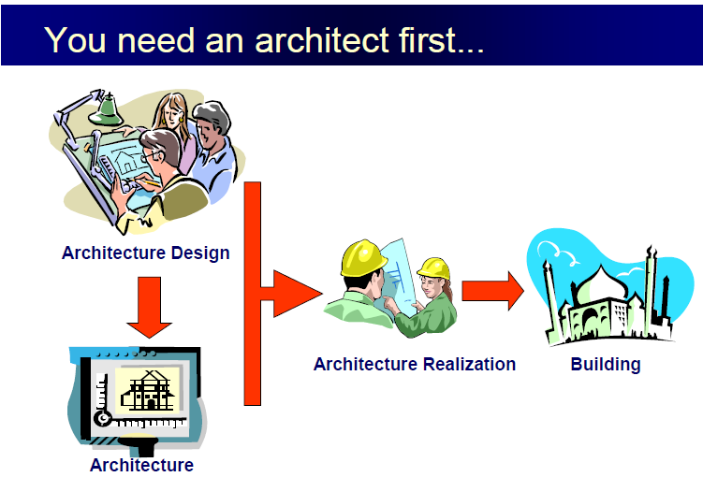


Slide 11
Defining the structure variable
Student std1; Defines a variable called std1.
This definition reserves space in memory for std1.
How Much Space ?
Enough to hold all the members of std1.
in this case 4 bytes for each of the two int (assuming a 32-bit system) and 4 bytes for float.

Slide 12
Accessing Structure Members
Once a structure variable has been defined, its members can be accessed using dot operator(.) called member access operator.
std1.rollno
The name of the structure variable (std1) the member access operator(.) and the member name(rollno).
Assigning the values to structure membes.
Std1.rollno=2; std1.obtMarks=500;

Slide 13
Initializing Structure Members
struct students {
int rollno;
int obtMarks;
float per; };
Void main() {
students std1={2,500,75.5F};

Slide 14
Nested Structures
Structures within structures.
struct Author
{
string author1;
string author2;
};
struct Books
{
string b_Name;
Author authorname;
};

Slide 15
Accessing Nested Structure Members
int main()
{
Books book1;
book1.b_Name="C++";
book1.authorname.author1="Ali";
}

Slide 16
enumeration
structure provides a way to define user defined datatypes.
enumeration is an other approach to define your own data types.
An enumeration defines a set of constants.
An enumeration is a list of all possible values.
enumerations are used when you know in advance a finite (usually short) list of values that a datatype can take on.

Slide 17
enumeration declaration
An enum declaration defines the set of all names that are permissible values.
These permissible values are called enumerators.
enum days_week {Mon, Tues, Wed, Thu, Fri, Sat, Sun};

Slide 18
enum days_week{Mon, Tues, Wed, Thu, Fri, Sat, Sun};
int main()
{
days_week day1=Mon;
days_week day2=Thu;
cout<<"day1="<<day1;
cout<<"\n day2="<<day2;
cout<<"\n result="<<(day2>day1);
}

